Slide 1
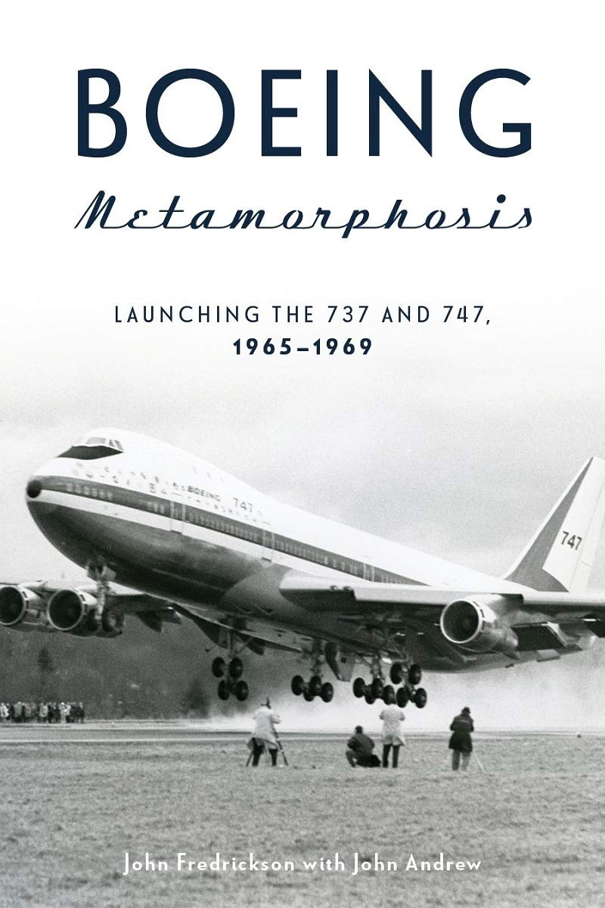
Some Additional
Comments on
Information Flow
Ron Westrum

Slide 2
Some comments on Cultural Efficacy
The famous Harvard Philosopher William James once wrote about something he called “The Will to Believe.” The will to believe had to do with groups of people and what they felt they could be accomplish. He said that with a will to believe, much could be done that was otherwise impossible.

Slide 3
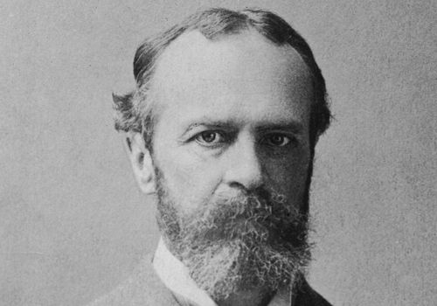
William James, Harvard University

Slide 4
Then there was physicist Enrico Fermi
In the process of creating the world’s first controlled atomic power reactor at Chicago, Enrico Fermi talked about “the will to think.” He said when came when the inventor came to believe that his/her invention would be funded, this created a “will to think.” The immediate situation was the creation of an atomic power source under the University of Chicago’s quadrangle tennis court. He said the government’s support was what supplied him with the will to think how the project could be created. And thus the “atomic pile” was created.

Slide 5
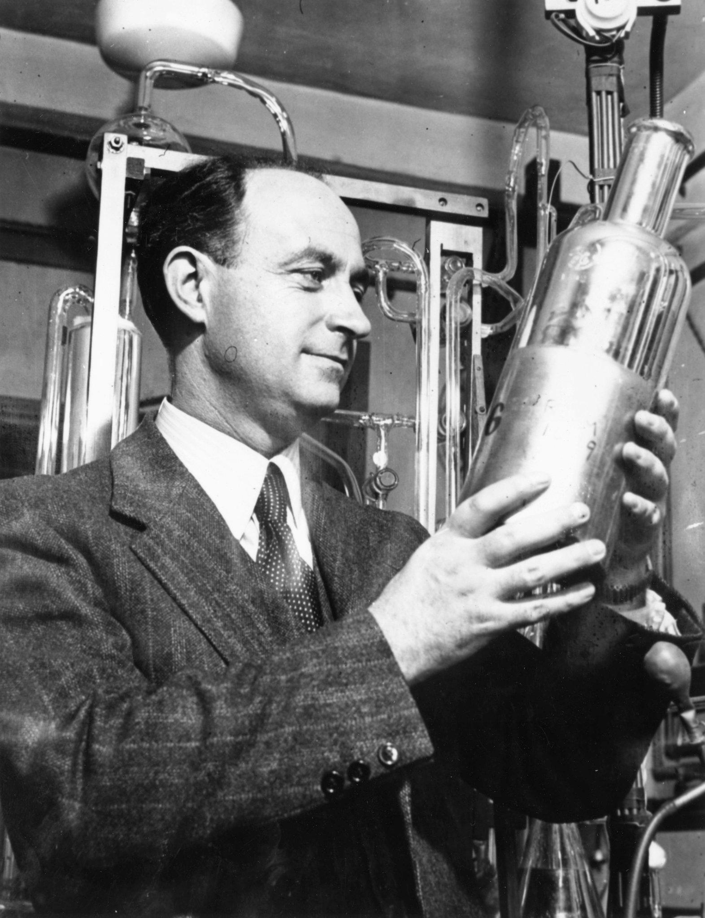
Enrico Fermi
Atomic Scientist

Slide 6
And finally, “Collective Efficacy”
So, some fifty years later, a University of Chicago “Neighborhood Study” brought in the concept of “collective efficacy,” invented by another Harvard Professor, Felton Earls. He used it to describe a neighborhood’s feeling about its own powers. Collective efficacy was the feeling that the people in a neighborhood would work together in solving its problems. This included people stepping up to do acts benefiting the public good, such as protecting against crime, helping old people cross the street, etc. This concept is what we need here.

Slide 7
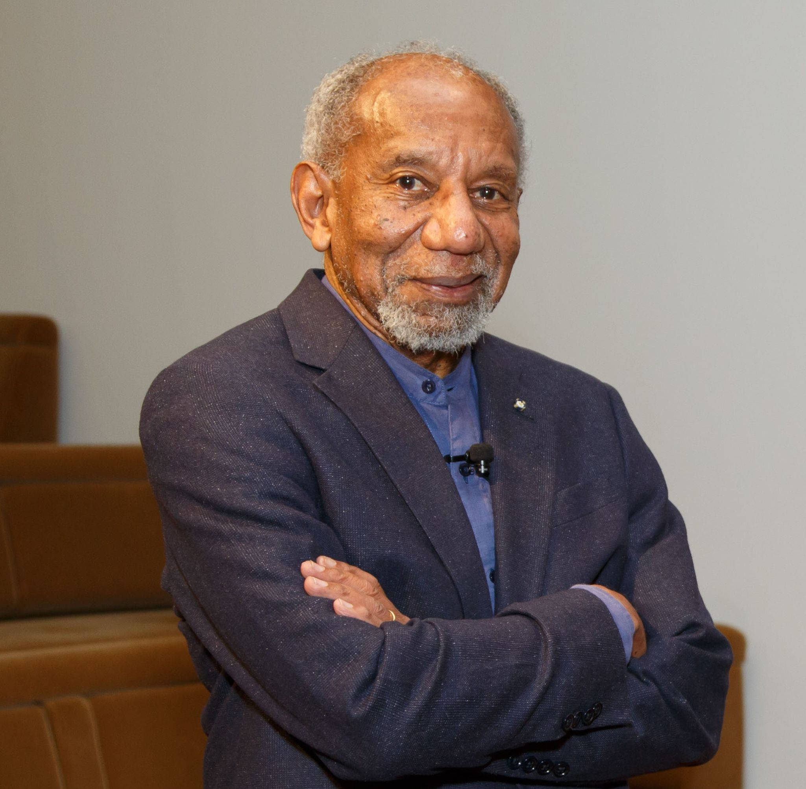
Felton Earls
Professor of
Psychiatry
Harvard University

Slide 8
Why is “collective efficacy” Important?
If we want to understand why legacy Boeing culture was so strong, we need to see it expressing a collective ability to work together for success. As I indicated before, building a new airliner is a masterful work of creation. The more one delves into the history of Boeing, the more this factor becomes evident. Working to success for a new airliner is a massive act of collective faith. Without this faith, the parts that make up the new airliner will not come together. There has to be a collective “will to believe” to get the effort.

Slide 9
So what is it that builds collective efficacy?
What is it that builds faith? The most obvious answer is “Promises Kept.” And to understand this, we have to look at the context---at Boeing’s history. So first:
Boeing had been building airplanes for two decades before World War II. But in that war, Boeing built a bomber that for all its faults, was absolutely key to winning the war. That bomber was the B-17 Flying Fortress. And then Boeing had built the B-29 Superfortress, an even more impressive aircraft.

Slide 10
Boeing’s chairman speaks in 1956
To put the value of the B-17 in context, I am going to read you a passage from Robert Serling’s fine book, Boeing: Legend and Legacy. The specific event was a U.S. House Armed Services Committee in 1956. The issue at hand was the profits of aircraft companies during World War II. On the fourth day of the hearings, Boeing representatives, including controller Clyde Skeen, held forth about prices and costs. After Skeen spoke, Boeing CEO William Allen was asked if he had any remarks to add to Skeen’s testimony

Slide 11
William Allen testifies off the cuff
So William Allen, Boeing’s CEO got up and testified off the cuff, and without a single note for 20 minutes. He pointed out that for $600 million in gross income, Boeing had made only $6 million in profits. He pointed out that pending legislation would allow them to make only 12% in profit, and that they never even got close to that. He said that Boeing was plowing 75% of these profits back into research and development, higher than the industry average. He urged them to consider not whether Boeing had made too much, but whether it had made enough.

Slide 12
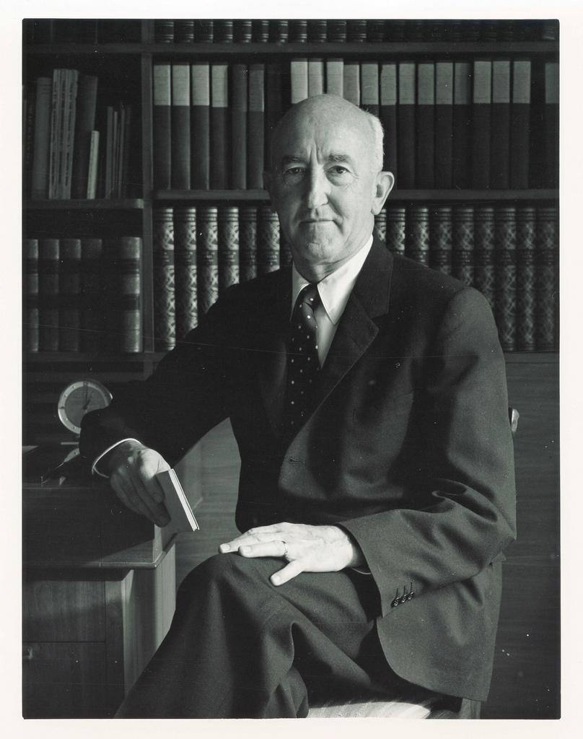
William Allen
Boeing CEO

Slide 13
Had Boeing helped to save the “free world?”
The Armed Services Subcommittee gave Allen a standing ovation after his speech.
One Committee member told him, “I think you were performing a tremendous service not only to the United States but for the entire free world, because if it were not for Boeing today, perhaps, there would be no free world.”
So here was a promise that was kept.

Slide 14
So Boeing’s military and space experience was important for the country and for Boeing itself.
This included not only vital warplanes, such as the B-17, the B-29, B-47 and B-52, but missiles such as the Minuteman, space efforts such as the Lunar Orbiter and the first stage, S-1C that was part of the Saturn 5 rocket. Skilled engineers moved from one project to another, moving expertise and ideas.

Slide 15
But I wanted to focus on Faith
Boeing as a company worked on many projects at once. Engineers would be shuffled back and forth as new projects arose, and others reached their maturity. But one of the truly great projects of Boeing, the 747 project, did not seem born “under a lucky star.” Indeed, the supposed high talent of Boeing in the late 1960’s was focused on designing a Supersonic Transport. Joe Sutter, the chief engineer for 747 project, remembers coming into Washington one night tired, and looking for a rest.

Slide 16
Sutter finds himself in a backwater?
Instead, at the hotel Sutter found himself among 20 of Boeing’s “star power” engineers who were working on the Supersonic Transport. They took him for a drink, and tried to encourage him by saying, “Do OK on the giant jet, and we will find you a place on the SST team.”
Sutter was taken aback. Was his 747 project a backwater? Clearly, the big money was on the Supersonic entry. So were the top engineers. What was he to do?

Slide 17
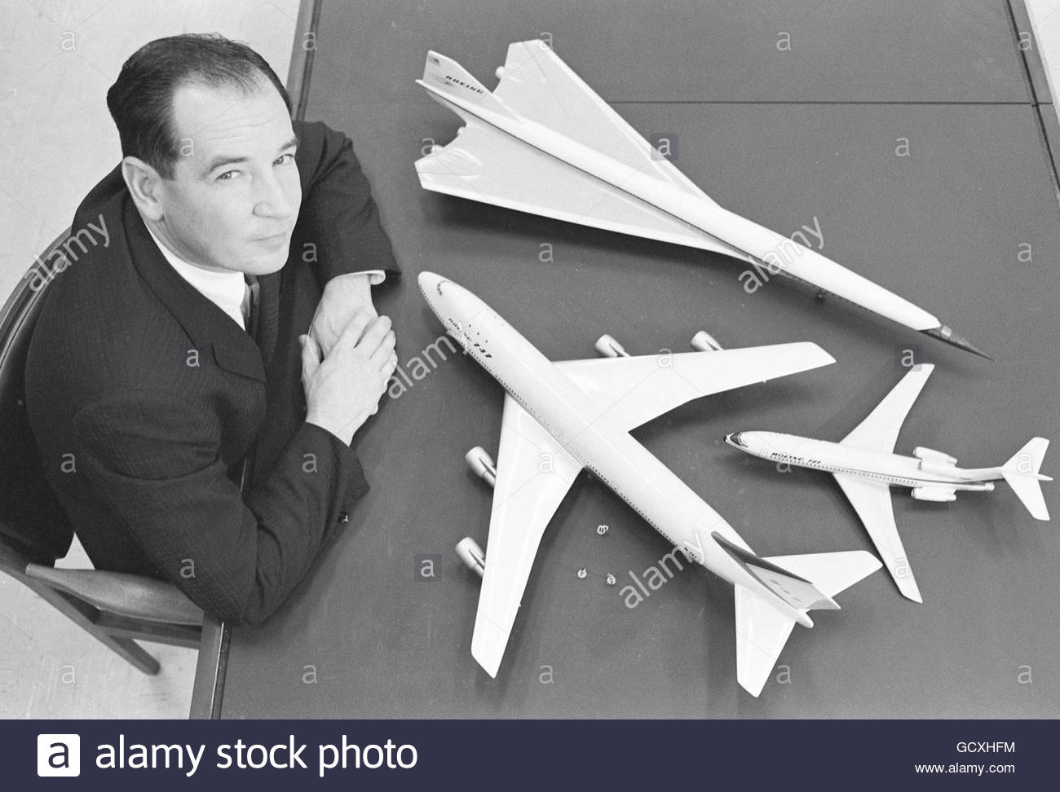
In the end, Boeing did not build the SST

Slide 18
Sutter takes heart
But Sutter was not about to leave his assignment until it was a success. Another evening, he had a long talk with his #2 engineer, who was depressed. He was able, he writes, to make the man feel a lot better about the project. And from that moment, he realized that everybody on the team needed to feel “a lot better” as well. So he took as his task providing the leadership, information, and faith that would see the project through. But that was only one of his challenges.

Slide 19
Challenges for the 747 Project
Make sure that the project was coherent, that the plane designed was the plane needed.
Come up with the funding to pay for the thousands of engineers and designers involved.
Parry challenges to his authority by others who had different ideas.
Keep everybody on track and believing that the project was do-able.

Slide 20
The “Incredibles”
Joe Sutter was able to do all this because he had faith in his design instincts, in his company, and above all in his engineering team, 6,000 engineers he called “the Incredibles.” What he expected, and what the situation required was long periods of 10-hour days and seven-day weeks. He may not have rounded up all Boeing’s smartest engineers, but he had a circle of faith that got results. He believed that it could be done, and so did his team.

Slide 21
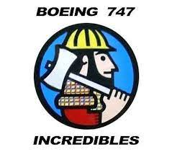
The Incredibles

Slide 22
Dodging the Brickbats of Fate
The 747 was to be bigger and better than other airliners. But it also had titanic problems.
Where was it going to be built? Where was a big enough space to build the behemoths?
Boeing had other airliners to build, against which 747 had to fight for resources, e.g. the 737.
It took a long time to get the engines to work right.
Boeing was running out of money for the start-up.

Slide 23
Fighting City Hall
Joe Sutter said, “I had trouble getting everything from good people to facilities priority in the wind tunnel. I had to fight city hall , as it were, every step of the way to get the 747 designed, built, certified, and into service.”
And then, as rollout began, there were major engine problems and Boeing faced running out of money. A recession arrived. Layoffs began, and went up to 60 thousand layoffs. Boeing was headed for the dumper.

Slide 24
But then they solved the problems
The recession went away.
They got the engines working
They got the funds
Then they started producing 747s
Yet there had been some very bad years in between. Boeing nearly came apart.
So why did they not give up, and liquidate the firm?

Slide 25
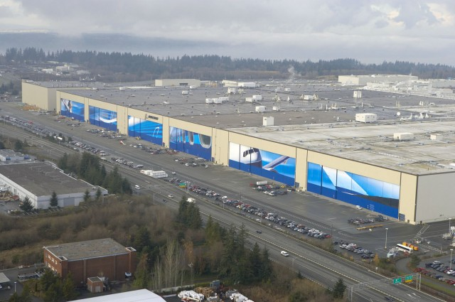
They built the world’s largest factory

Slide 26
They built
a lot of 747’s

Slide 27
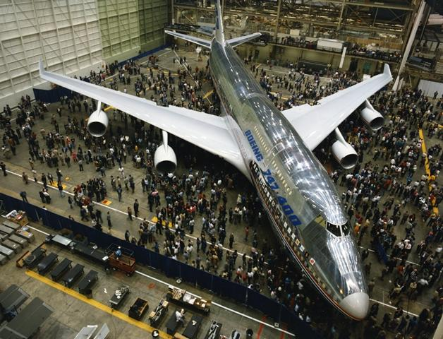
The 747 changed how people flew and thus changed the world

Slide 28
The Triumph of Faith
That moment of truth brings us back to the issue of faith. Boeing’s “collective efficacy” meant that they had faith in themselves, in their ability to continue the job and finish it. It came from all the promises that had been made and kept. They had built the bombers, propeller and jet, they had built the jet airliners, the 707’s--and all their derivatives. They were building the 737, the most popular airliner ever. They built the 747, a world-changing passenger plane. The baton had been passed, again and again, and they completed big projects.

Slide 29
But with the merger, doubt entered in
Boeing had helped to create the USA of the late 20th century. But the airliner business was a technical success. It did not make as much money as it could, and therefore, some thought, it needed to be tweaked so that it was going to make more money. Never mind that it had already done the impossible, never mind that the 747 team had been the “Incredibles.” Boeing needed to become, said one school of thought, incredibly financially successful.

Slide 30
The merger with Mc-Dac led to problems
The new personnel from McDonnell-Douglas brought the Harvard Business School approach to something that was a working cultural icon, and insisted that it change. Now it needed to be financially responsible. Who could argue with that? Who would argue with that?
So, they moved the headquarters to Chicago. Why? To be closer to the financial center of the United States.

Slide 31
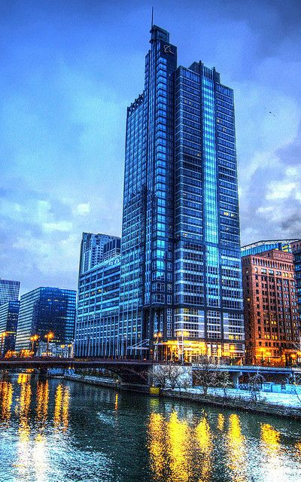
Boeing headquarters Chicago

Slide 32
But what about keeping faith?
The move to Chicago was a move that would take management further from the engineers. No longer was the goal of Boeing to be making planes. Now it was to make money. This was a breach of faith, a promise broken.
If you break a covenant, there is a price. The price was that Boeing was no longer to be a “great organization” whose purpose is to do the impossible. When working loses its higher meaning, it is “just a job.”

Slide 33
Morale sagged
Major studies of morale at Boeing showed that the new corporate culture of “Teams” instead of “family” shaped a lower buy-in to the corporate culture. Reams of worker email showed that now Boeing was not being taken seriously. One email spoke of “clowns being managed by monkeys.” Corporate shenanigans demoralized the workforce and reflected badly on corporate leadership.

Slide 34
Corporate integrity broke down
The new century witnessed the failure of corporate leadership to maintain a high standard of integrity. William Allen, as CEO, would not abide deception and dishonesty. But when Stonecipher was fired for having an illicit affair, and Condit was forced to resign over the actions of his subordinates, Boeing looked bad to the public and to its workers.

Slide 35
The shady maneuvers around 737 Max
Added to all the other problems, the shaky development of the 737 Max brought all the negative forces to the fore. The idea of Boeing regulating itself, by absorbing the FAA function internally, with all the conflict of interest that involved, was clearly dishonest, was the opposite of good practice. Then the failure to explain the new MCAS software, and not embedding it firmly in training and simulation, made people feel rotten. This was the opposite of Legacy Boeing’s conduct. People knew that things were not right.

Slide 36
The accidents merely confirmed what Boeing workers felt
When the organization is not right, the planes are not right. Boeing had not been a perfect organization. But it had been an organization, workers felt, that was trying to do the right thing. But now that organization was bent. Whereas pilots in the late 20th century had trusted Boeing more than Airbus, now this was reversed. The circle of faith had been broken, and repair would take time, if it took place at all.

Slide 37
Another circle of faith. Building the moon lander at Grumman
So now let me speak about another circle of faith, the faith that unites the creators of a technology and its users. To do so we will go to the aftermath of Apollo 13 space accident. As you may remember, the Apollo 13 suffered a blowout in space. “Houston, we have a problem.” The three astronauts on board Apollo 13 were guided to do emergency repairs, re-program their course, and eventually brought safety back to earth. This was a saga. But it did not end when the astronauts got back. There was one more thing to do.

Slide 38
The astronauts go to Grumman
After the 3 astronauts got safely back, they had to thank a group that had helped save their lives. That group was the Grumman Corporation, located in Bethpage, Long Island. The Grumman Corporation had designed the Moon Lander. In their voyage home, the astronauts had used the Moon Lander as a lifeboat, to cut down on energy consumption, until they could re-occupy the Command Module, which they used to come back through the atmosphere. But that use had been anticipated in Grumman’s design of the lander.

Slide 39
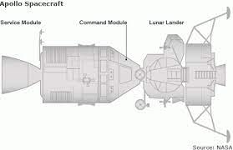
Lunar Lander Layout

Slide 40
The design of the moon lander
The use of the Lander as a lifeboat had been anticipated by its designers at Grumman. It had been designed with extra supplies and utilities that allowed a crew to survive in it for a short time of crisis. When the blowout occurred, the crew could go into it for a while. An emergency had been foreseen, although its exact shape was unknown. The astronauts went back to Grumman to thank the designers for their foresight, what one might call their “requisite imagination.”

Slide 41
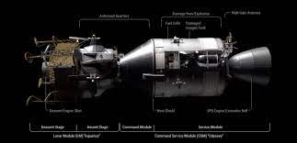
Moon lander, Command Module, and Service module

Slide 42
Back in WWII
But the design of the Moon Lander harked back to World War II, when Grumman, having already designed the F4F Wildcat, an excellent aircraft, upgraded it to the F6F Hellcat, probably the finest carrier plane in WWII. Grumman had listened carefully to its pilots in the Pacific, and Jake Swirbul, a Grumman vice-president had gone to the Pacific to find out what they wanted. But the underlying philosophy was to protect the pilot. Grumman planes were part of the circle of faith between

Slide 43
Michael Ciminera’s comments
“This aircraft design philosophy embodied a very rugged structure with reliable systems able to sustain significant damage that would allow the pilot to complete his mission and return home safely.”

